Slide 1

WEEK 7 VAPT (WEB APPLICATION TESTING WITH BURP SUITE)
NAME: B SAI AMULYA GOUD
SIN: DG/SEPTEMBER/CYBER/179

Slide 2
OBJECTIVES
  Burp Suite Setup and Configuration: To install Burp Suite Community Edition and configure the browser proxy for intercepting HTTP and HTTPS traffic.
  HTTP Request Interception: To capture, inspect, and analyze HTTP requests and responses, including login requests and session-related information.
  Web Application Reconnaissance: To explore the target application and identify accessible pages, directories, endpoints, login forms, and input fields.
  Application Mapping: To use Burp Suite's Target Site map and HTTP history features to understand the structure and attack surface of the web application.
  Vulnerability Identification: To investigate common web application vulnerabilities, including SQL Injection, Cross-Site Scripting (XSS), authentication weaknesses, and parameter tampering.
  Manual Security Testing: To use Burp Suite tools such as Proxy and Repeater to modify requests, compare server responses, and verify suspected vulnerabilities.
  Directory and Endpoint Discovery: To identify accessible and potentially hidden application resources using Burp Suite and directory discovery tools such as Dirsearch or Gobuster.
  Evidence Collection: To capture screenshots of relevant requests, responses, browser behavior, and testing results to support vulnerability findings.
  Vulnerability Assessment and Reporting: To document identified vulnerabilities with descriptions, reproduction steps, evidence, impact, severity, and remediation recommendations.
  Security Awareness and Best Practices: To understand common web application security risks and recommend appropriate mitigation techniques to improve application security.
  Practical Skill Development: To gain hands-on experience in web application penetration testing, HTTP traffic analysis, attack-surface mapping, and security report preparation.

Slide 3
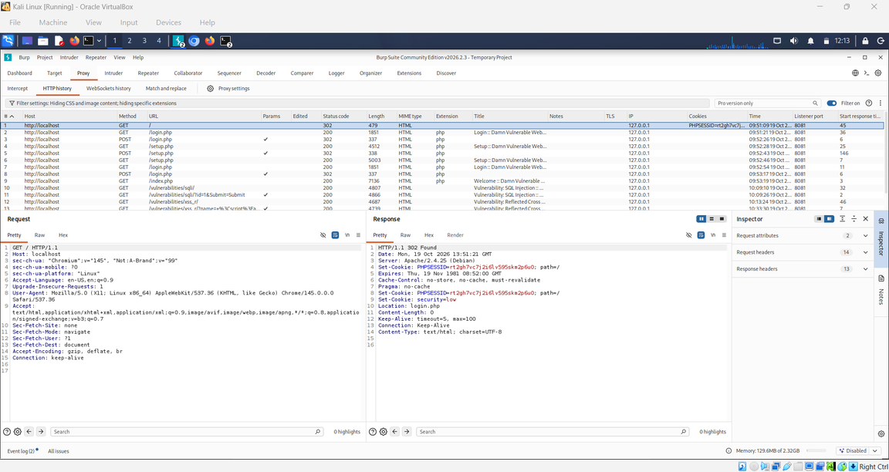
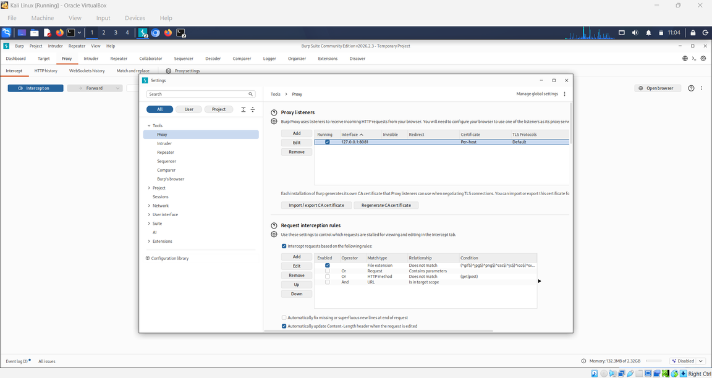
TASK 22 BURP SUITE SETUP & INTERCEPTION

Slide 4
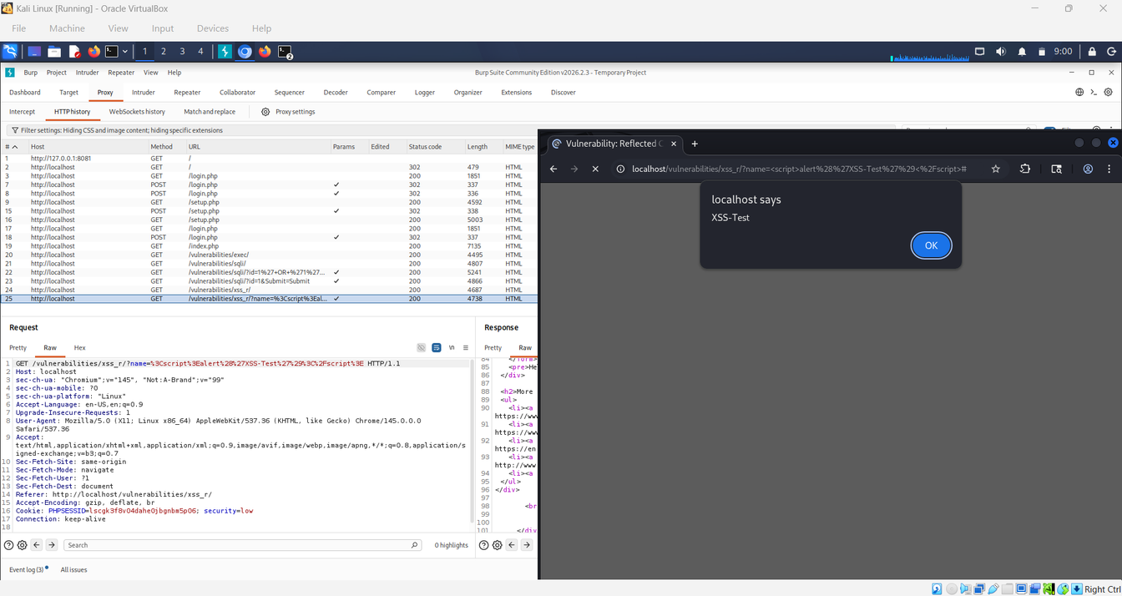
TASK 23 RECONNAISSANCE AND MAPPING A WEB APPLICATION
XSS (Reflected):

Slide 5
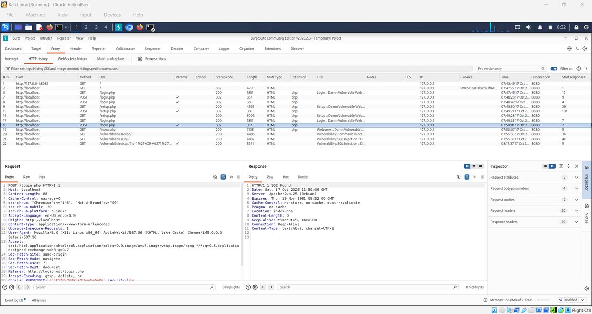
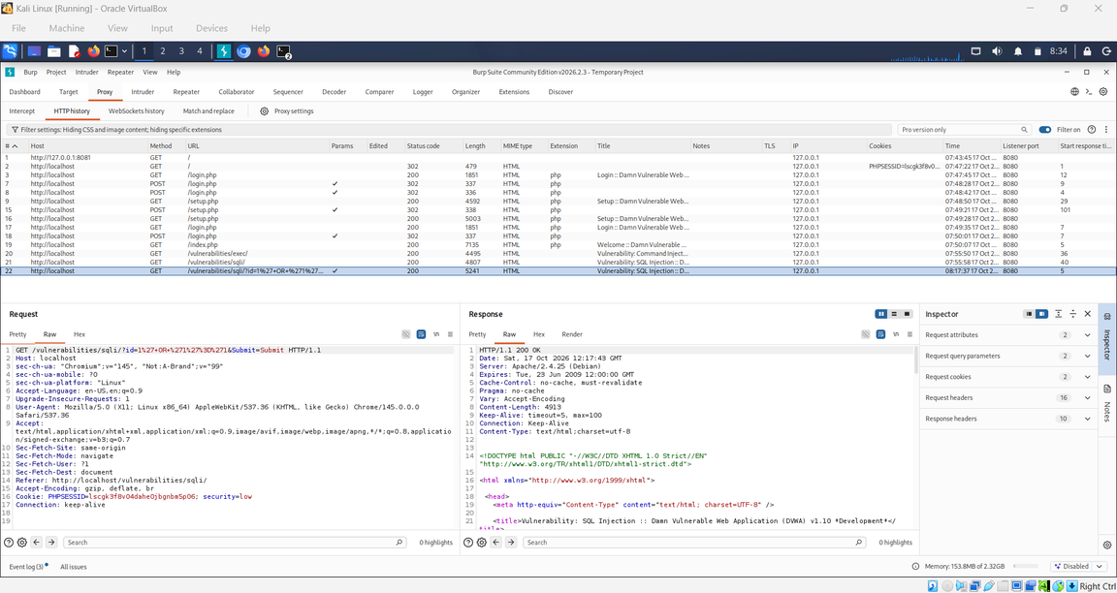
SQL Injection:

Slide 6
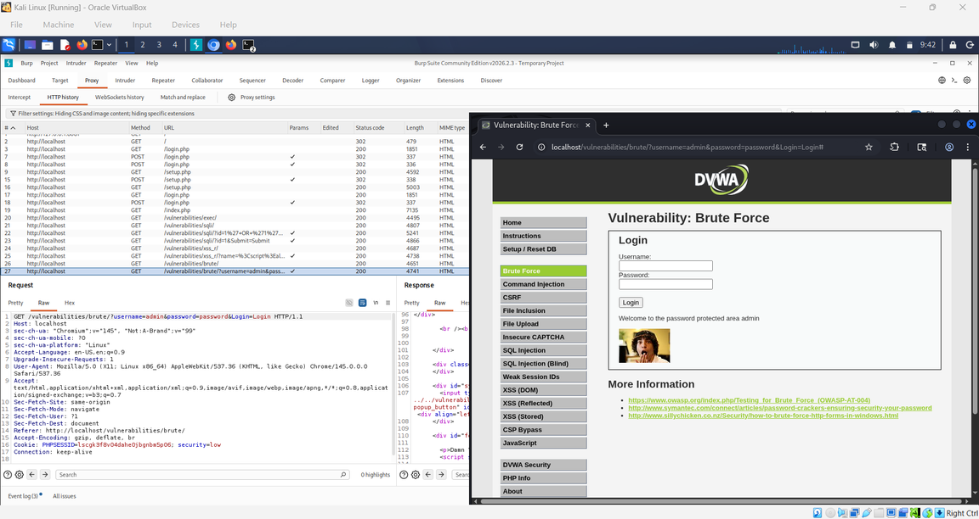
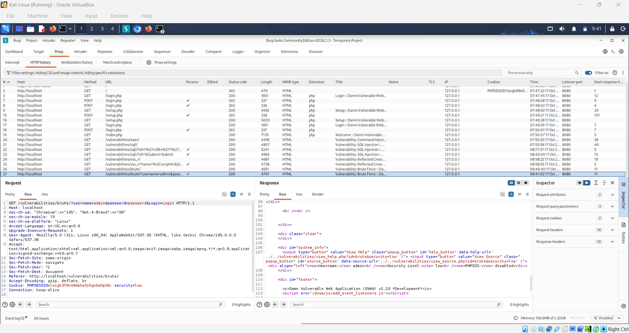
Brute:

Slide 7
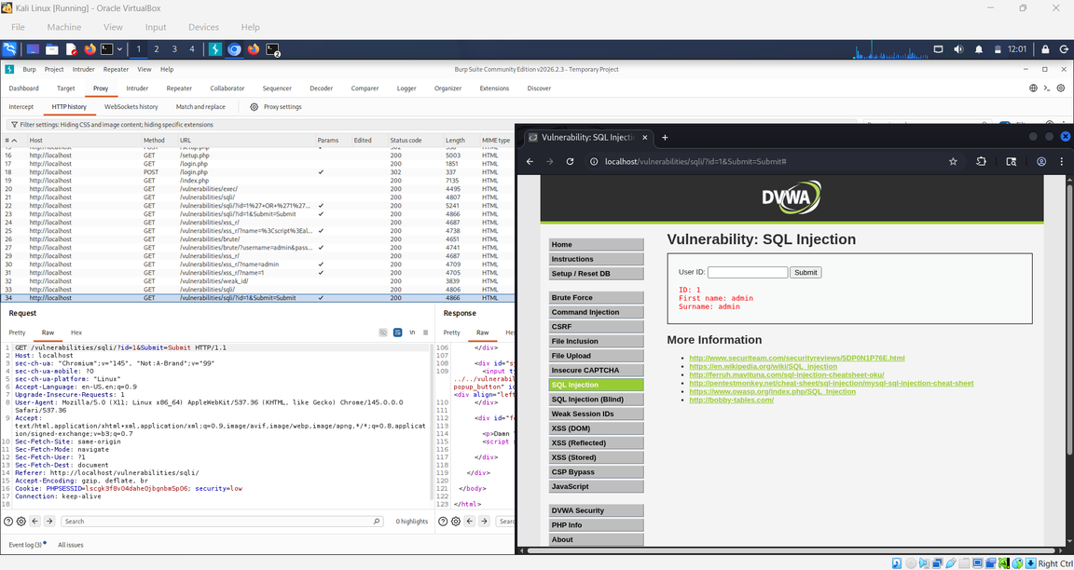

TASK 24 VULNERABILITY TEST
SQL Injection:
INPUT: 1
OUTPUT: first name: admin
surname: admin
INPUT: 2
OUTPUT: first name: Gordon
surname: Brown

Slide 8
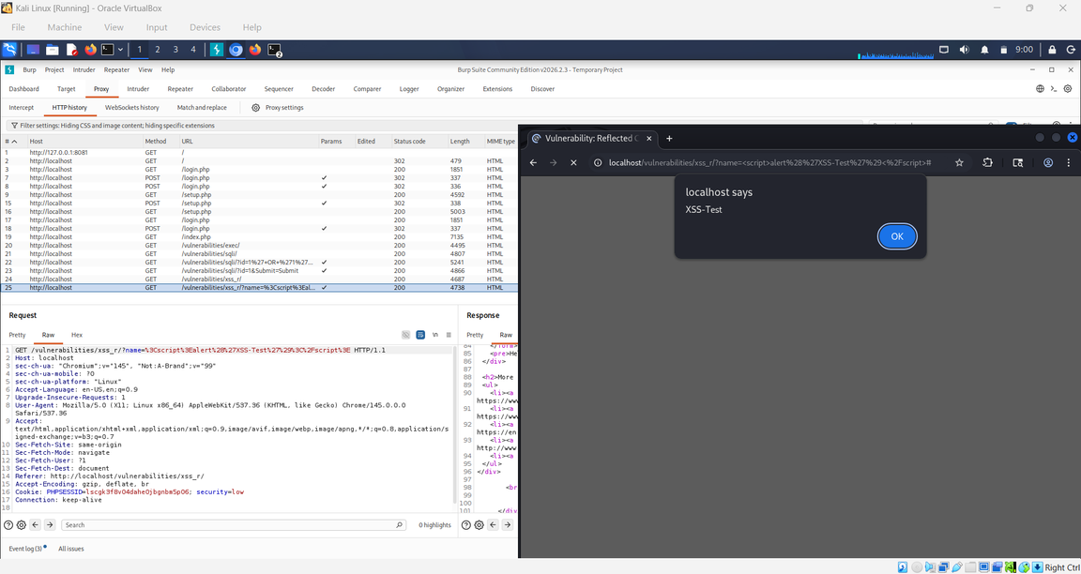
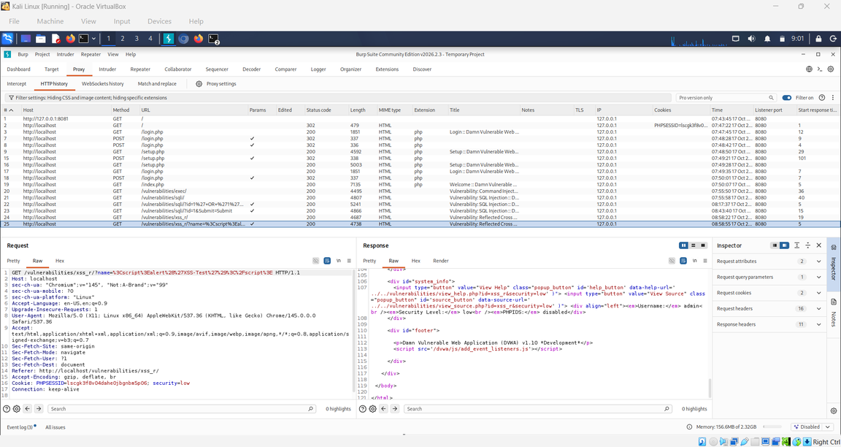
XSS (Reflected):
INPUT: <script>alert('XSS-Test')</script>
OUTPUT: XSS-Test

Slide 9
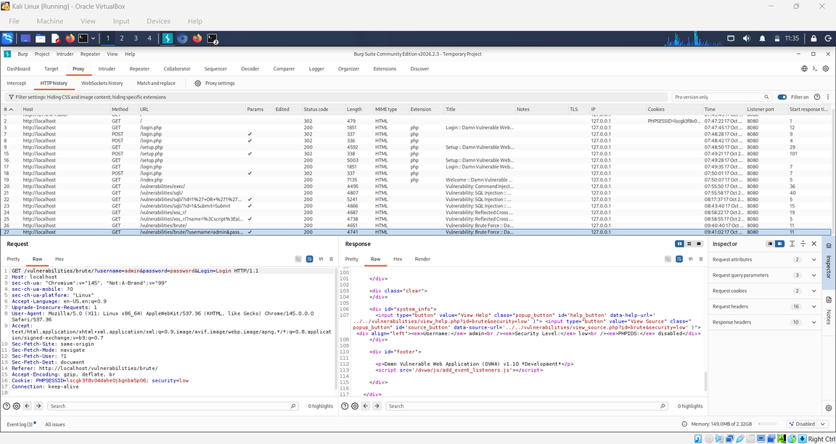
Brute:
INPUT: first name: Username: admin
Password: password
OUTPUT: Welcome to the password protected area admin

Slide 10
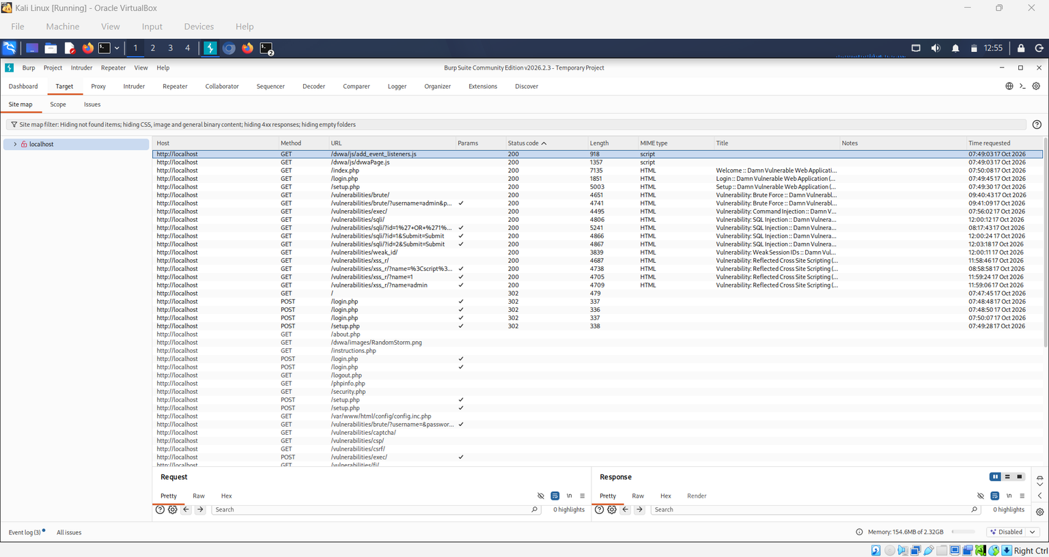
TASK 25 DIRECTORY & ENDPOINT DISCOVERY

Slide 11
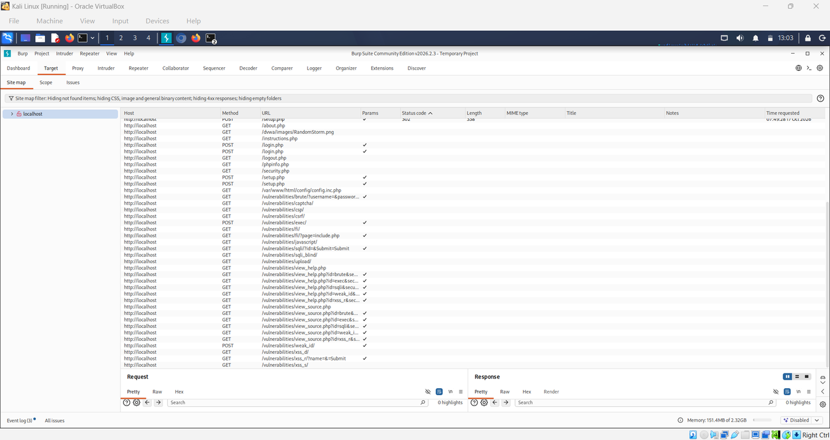
Map endpoints
The Target → Site map section was used to examine the application's structure. The discovered resources were organized by host and path.

Slide 12
CONCLUSION
The Week 7 Web Application Vulnerability Assessment and Penetration Testing (VAPT) assignment provided practical experience in identifying and analyzing common web application security vulnerabilities using Burp Suite Community Edition, Kali Linux, and Damn Vulnerable Web Application (DVWA) in a controlled laboratory environment.
During this assignment, Burp Suite was configured to intercept and inspect HTTP requests and responses. The application's endpoints, login functionality, input fields, and parameters were explored using the Proxy and Target Site map features. Manual testing was performed using Burp Suite Repeater to examine application behavior and identify potential security weaknesses.
The testing successfully demonstrated SQL injection and reflected Cross-Site Scripting (XSS) in the intentionally vulnerable DVWA application. Authentication-related testing and endpoint discovery were also explored. Screenshots and request-response evidence were collected to support the findings and document the testing process.

Slide 13
THANK YOU

